Slide 1
WP6, 18th months report
16th June, 2019
J-F. Perrin (ILL)
on behalf of the WP6 team

Slide 2
WP6 aims
Support the PaNOSC services (WP3/4/5/8) to integrate EOSC.
Users’ productivity : remove technical hurdles, simplify users access to data and services.
Prepare RIs’ IT infrastructure for EOSC.
Today’s agenda
Authentication and Authorisation Infrastructure (AAI): common user authentication for all PaNOSC (EOSC?) services
Data transfer: bringing data to services or vice versa, quest for the right model (depending on the service type, data volume, …)
Other ongoing activities

Slide 3
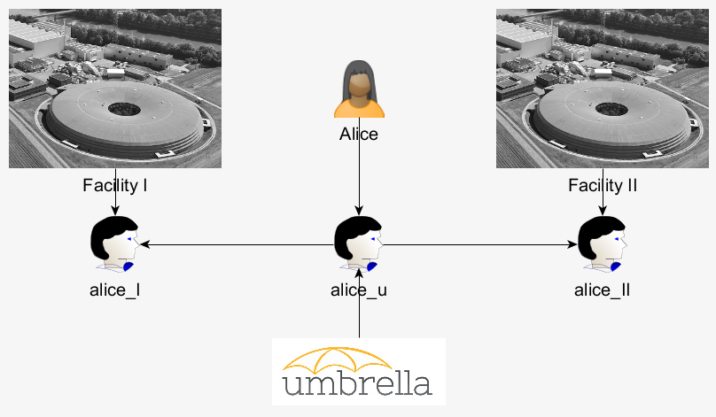

AAI
UmbrellaID is the AAI of the PaN community (PaNOSC + ExPaNDS + … ) since 2012
Provide a common Authentication and Authorisation Infrastructure that allows users of all PaN facilities to connect seamlessly to digital facility services with a single and unique ID (i.e. Common ID)
Authorisations remain in full control of each facility providing the services
Users are in full control of their personal data.
https://umbrellaid.org/what.html

Slide 4
AAI
PaNOSC objectives :
Integrate EOSC – I.E. move to the AARC BluePrint Architecture (BPA)
Reach global and comprehensive interoperability with services outside of the Photon and Neutron domain.
Cater from the growing security constraints and legal requirements
Increase capacity to respond to users’ needs in a stable, secure and trusted environment (training and support)
Collaborate closely with GÉANT to achieve the above objectives.

Slide 5
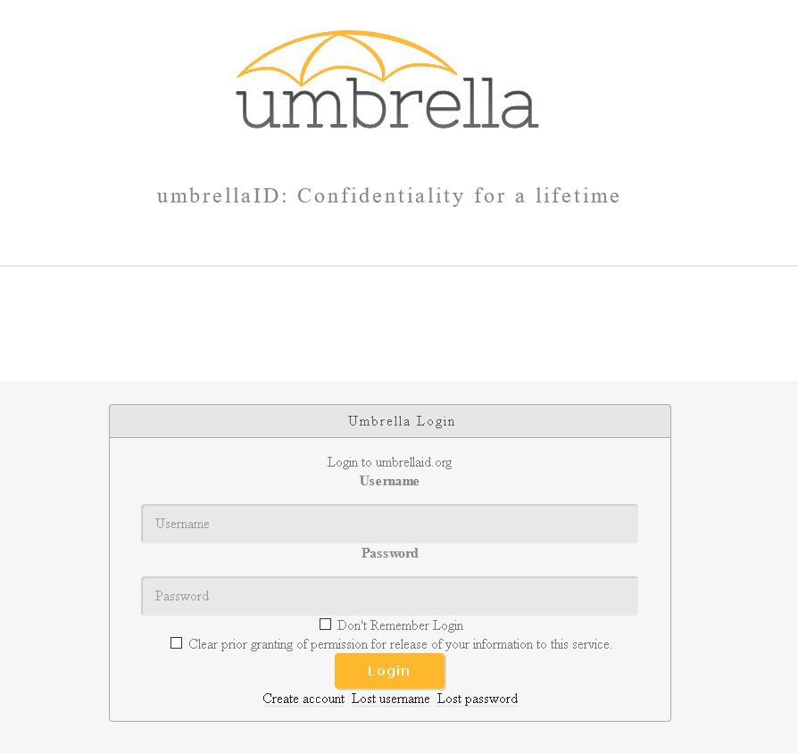
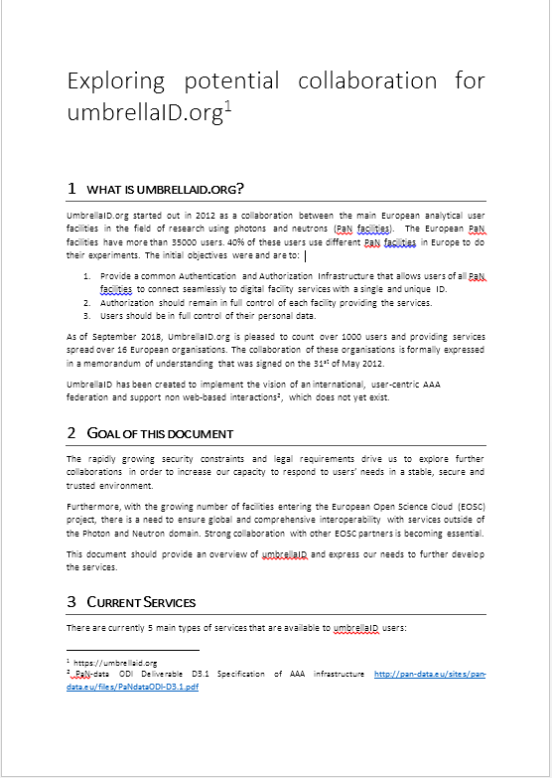
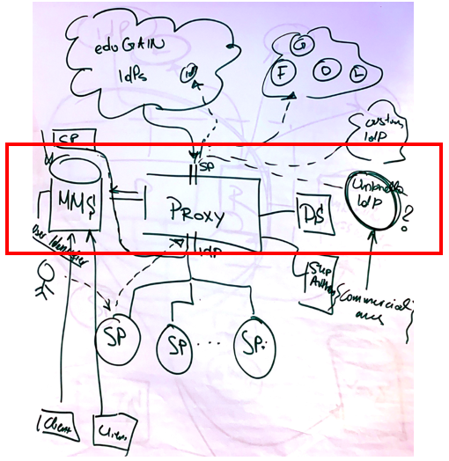
AAI
Looking for collaboration
Specifications
Initial contact with GÉANT
July 2019
Validation by the UmbrellaID mgmt. team.
Autumn 2019
Set up of the dedicated eduTEAMS platform
Validation
Spring 2020
Production ready
New services introduced
Summer 2020
Migration of all SP to the new infrastructure
Additional metadata
Autumn 2020
New IdPs: Orcid, eduGain
Migration of all users
Decommisioning UmbrellaID IdPs
Spring 2021

Slide 6
Data Transfer
3 identified uses cases
An RI wants to archive its experimental data in a remote data centre.
A user wants to access a data analysis service, data has to be available “transparently”.
A facility user wants to transfer a large dataset from an RI’s archive to a remote compute centre or her/his home PC.

Slide 7
2nd Use case: EGI Data-Hub
Objectives
Transfer data to ESOC data treatment services.
Transfer data transparently
Archive the results
Authenticate users using EOSC ready AAI (UmbrelaId)
Authorise data access (open or embargo data).

Slide 8


2nd Use case: EGI Data-Hub
Data treatment service
Community ?
HPC? Kubernetes? OpenStack?
Cache
Local network
GÉANT network (100’s km)
Archive
Archive
Archive
Archive
Demo after the presentation

Slide 9


Initial results
Data treatment service
Very promising pilot:
Provide the same interfaces for data independently of the archive location
Transfer is transparent from the users’ point of view
Performance with small datasets seems acceptable but performance tests are still limited due to the current crisis situation.
Still need to understand the limits (datasets size, … ) of the model.
Some difficulties have been encountered with the authorisation mechanism (should be fixed by the end of the month).
EOSC AAI model not ready for such a cross community use case (the UC has been transferred to the EOSC Architecture WG).
Acceptance tests to be done.
HPC? Kubernetes? OpenStack?
Cache
PaNOSC
Archive

Slide 10
Other activities:
Data transfer :
1st use case (archive): well advance, most technical solutions are in place – currently implementation of a file distribution catalogue (Rucio).
3rd use case (user driven transfer): discussion with EGI and Globus ongoing (privacy, security, business model)
Software catalogue: requirements from the community collected, developments are going to start.
EOSC portal, integration of PaN services, 2 services ready:
Software catalogue
E-Learning platform
10

Slide 11
Current status
D6.1 Report has been delivered on due time. MS19 slightly delayed (2/3 weeks)
Difficulties:
COVID crisis since Jan/Feb 2020
System/network admin job market is very high (extremely difficult to hire).

Slide 12
Thank you
wp6@panosc.eu

Slide 13
Metrics
KPI |  | Nov 2019 | May 2020
6.1.1 | Service Providers connected to eduTeams Umbrella | 0 | 2
6.1.2 | Services connected and accessible through eduTeams Umbrella | 0 | 1
6.1.3 | Users that have used at least one service | 0 | 0
6.1.4 | Number of partners that have set up data transfer | 0 | 1
D6.1 Report has been delivered on due time. MS19 slightly delayed (2/3 weeks)
Difficulties:
COVID crisis since Jan/Feb 2020
System/network admin job market (extremely difficult to hire).

